Slide 1
Few-Shot Learning
Hyemi Jang

Slide 2
Overview
Few-shot Learning
Methodologies
Meta Learning
Metric Learning
Data Augmentation
Dataset and Github Code
Beyond Few-shot Learning

Slide 3
Overview
Few-shot Learning
Methodologies
Meta Learning
Metric Learning
Data Augmentation
Dataset and Github Code
Beyond Few-shot Learning

Slide 4
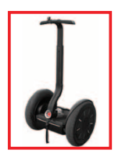
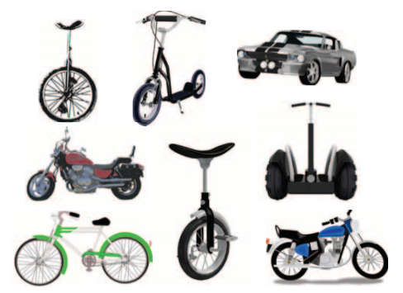
Few-shot Learning
Few-shot Learning
Learning from a small size dataset
N-way K-shot Learning
N: the number of classes
K: the number of examples per class
Why it is needed?
Getting a labelled dataset is expensive
It brings deep learning more adaptive to real-world usecases

Slide 5
Few-shot Learning
Few-shot
Learning
Meta Learning
Learn a learning
strategy to adjust well to a new few-shot learning task
Metric Learning
Learn a ‘semantic’ embedding space using a distance
loss function
Data
Augmentation
Synthesize more
data from the
novel classes to
facilitate the
regular learning
http://www.research.ibm.com/haifa/dept/imt/IMVC19/IMVC2019%20-%20Few-shot%20learning.pptx

Slide 6
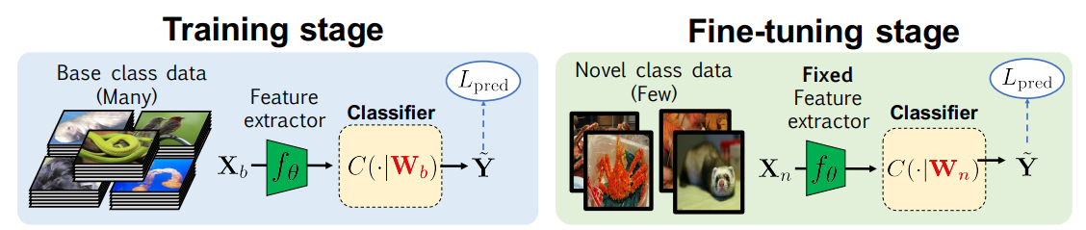
Naïve approach
Train with a few data
Overfitting problem
Transfer learning
Using pre-trained model from a large dataset
Chen, Wei-Yu, et al. "A closer look at few-shot classification." arXiv preprint arXiv:1904.04232 (2019).

Slide 7
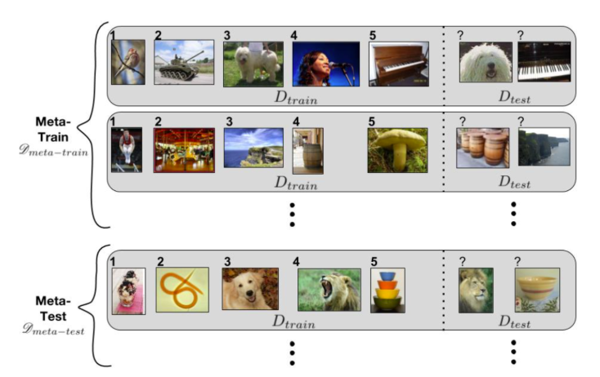
Few-shot learning Task
Episode : a unit consisting of a train set and a test set
Train set : N-way K-shot task
Test set : evaluating the model trained with the train set
Ravi, Sachin, and Hugo Larochelle. "Optimization as a model for few-shot learning." (2016).

Slide 8
Overview
Few-shot Learning
Methodologies
Meta Learning
Metric Learning
Data Augmentation
Dataset and Github Code
Beyond Few-shot Learning

Slide 9
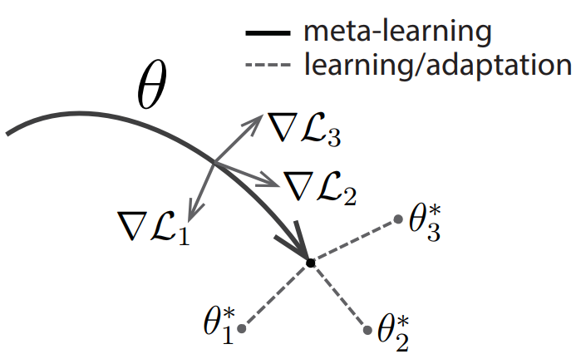
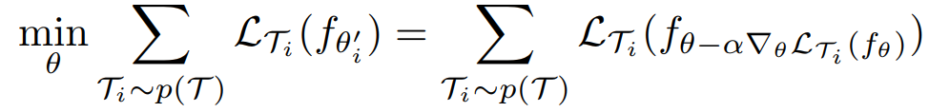
Meta Learning
Model-Agnostic Meta-Learning for Fast Adaptation of Deep Networks
Train a meta-learner which is able to rapidly adapt to various tasks
In other words, MAML aims to learn good initial neural network parameters.
MAML is a flexible algorithm that can be readily applied to a broad range of architectures and task domains
Finn, Chelsea, Pieter Abbeel, and Sergey Levine. "Model-agnostic meta-learning for fast adaptation of deep networks." Proceedings of the 34th International Conference on Machine Learning-Volume 70. JMLR. org, 2017.

Slide 10
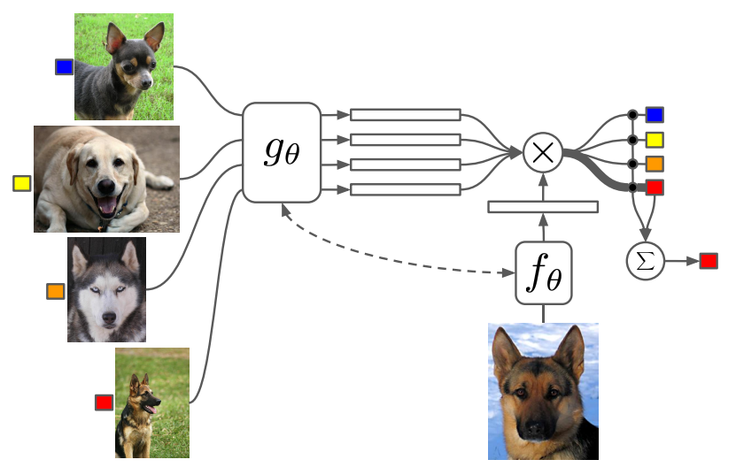
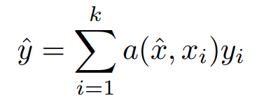
Metric Learning
Matching Networks for One Shot Learning
Parametric (Embedding) + Non-parametric (Support set)
Learn a meta embedding matrix
Classify an unlabeled data using attention measured by the cosine distance between the support set and the data
,
Vinyals, Oriol, et al. "Matching networks for one shot learning." Advances in neural information processing systems. 2016.

Slide 11
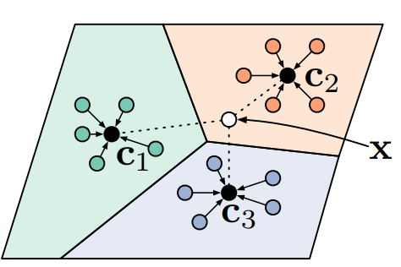
Metric Learning
Prototypical Networks for Few-shot Learning
Learn a non-linear mapping of the input to an embedding space using a neural network
Classify an example by comparing the distance between the prototype representations and the example
$P_{θ}\left(y | x,C\right)$=$softmax\left(−L_{2}\left(f\left(x\right),c_{i}\right)\right)$
Snell, Jake, Kevin Swersky, and Richard Zemel. "Prototypical networks for few-shot learning." Advances in Neural Information Processing Systems. 2017.

Slide 12
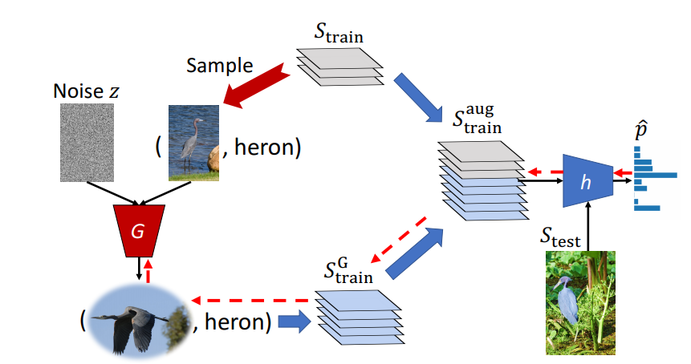
Data Augmentation
Low-Shot Learning from Imaginary Data
Augment a dataset generated by a ‘hallucinator’
Add a significant performance boost to the latest meta-learning methods
Wang, Yu-Xiong, et al. "Low-shot learning from imaginary data." Proceedings of the IEEE Conference on Computer Vision and Pattern Recognition. 2018.

Slide 13
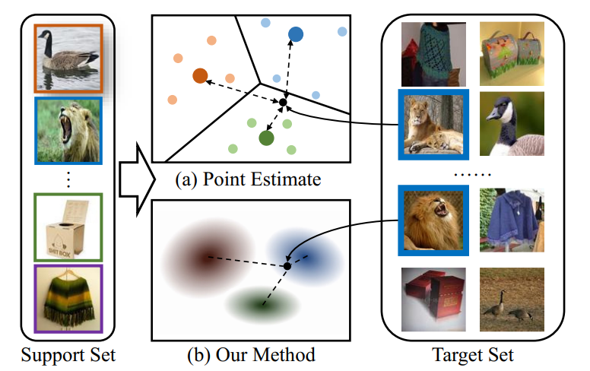


Additional Methods
Variational method
Estimates distributions instead of points
Zhang, Jian, et al. "Variational Few-Shot Learning." Proceedings of the IEEE International Conference on Computer Vision. 2019.

Slide 14
Overview
Few-shot Learning
Methodologies
Meta Learning
Metric Learning
Data Augmentation
Dataset and Github Code
Beyond Few-shot Learning

Slide 15
Dataset and Github Code
Dataset
Omniglot: http://www.omniglot.com/
Mini-ImageNet: https://github.com/y2l/mini-imagenet-tools
CIFAR-FS : https://github.com/kjunelee/MetaOptNet
FC100 : https://github.com/kjunelee/MetaOptNet
Code
MAML : https://github.com/cbfinn/maml
Matching Networks : https://github.com/markdtw/matching-networks
Prototypical Networks : https://github.com/jakesnell/prototypical-networks

Slide 16
Overview
Few-shot Learning
Methodologies
Meta Learning
Metric Learning
Data Augmentation
Dataset and Github Code
Beyond Few-shot Learning

Slide 17
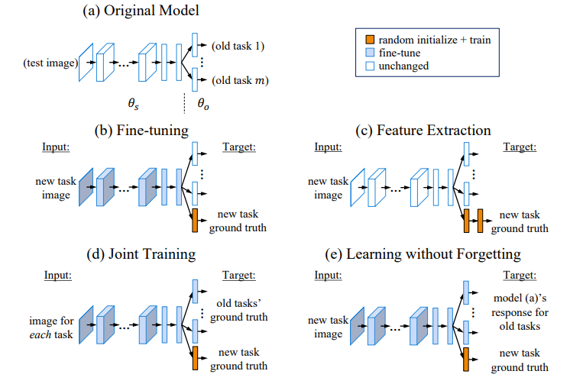
Learning without Forgetting (LWF)
Learn parameters that work well on old and new tasks, using images and labels from only the new task (i.e., without using data from existing tasks.)
Li, Zhizhong, and Derek Hoiem. "Learning without forgetting." IEEE transactions on pattern analysis and machine intelligence 40.12 (2017): 2935-2947.

Slide 18
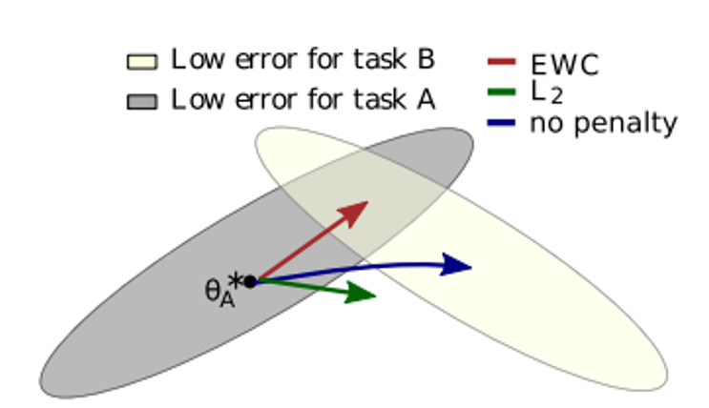
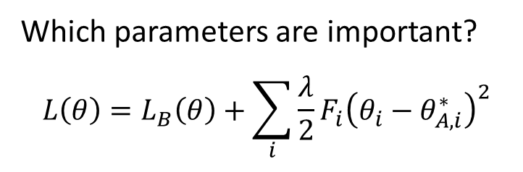
Elastic Weight Consolidation (EWC)
Learn a new task while maintaining previous task by less changing important weights.
Which parameters are important?
$$L\left(θ\right)=L_{B}\left(θ\right)+\sum_{i}{\frac{λ}{2}F_{i}{\left(θ_{i}−θ_{A,i}^{∗}\right)}^{2}}$$
Kirkpatrick, James, et al. "Overcoming catastrophic forgetting in neural networks." Proceedings of the national academy of sciences 114.13 (2017): 3521-3526.

Slide 19
References
Finn, Chelsea, Pieter Abbeel, and Sergey Levine. "Model-agnostic meta-learning for fast adaptation of deep networks." Proceedings of the 34th International Conference on Machine Learning-Volume 70. JMLR. org, 2017.
Vinyals, Oriol, et al. "Matching networks for one shot learning." Advances in neural information processing systems. 2016.
Snell, Jake, Kevin Swersky, and Richard Zemel. "Prototypical networks for few-shot learning." Advances in Neural Information Processing Systems. 2017.
Wang, Yu-Xiong, et al. "Low-shot learning from imaginary data." Proceedings of the IEEE Conference on Computer Vision and Pattern Recognition. 2018.
Li, Zhizhong, and Derek Hoiem. "Learning without forgetting." IEEE transactions on pattern analysis and machine intelligence 40.12 (2017): 2935-2947.
Kirkpatrick, James, et al. "Overcoming catastrophic forgetting in neural networks." Proceedings of the national academy of sciences 114.13 (2017): 3521-3526.

